Slide 1


Slide 2
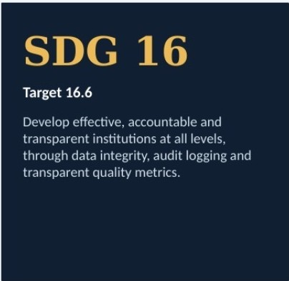
Objectives and SDG alignment
GOALS
•
Define dataset schemas with typed fields
•
Configure rules: REQUIRED, UNIQUE, EMAIL, RANGE, TYPE
•
Upload CSVs and generate row-level quality issues
•
Compute a 0-100 quality score automatically
•
Keep a verifiable audit trail of every resolution
DataPulse I BCSE302P Database Systems Lab
3

Slide 3


Team and ownership
WHO BUILT WHAT
BS
Udiksha Agaiwal
24BAI0086 , branch: back md
Bakya Sri
24BAJ0071 I branch: frontend
Rudra Bhatt
24BKTOl25 , branch: clouddatabase
Spring Boot 3.5 and Express APls. JPA/Hibernate and Prisma, BCrypt, JWT, RBAC, transactional validation engine
React 19 UI. Vite build, SPA navigation, dataset/field/rule managers, issue tables, resolution modals. form validation
PostgreSQL 18 schema 1n 3NF, 10 tables. indexes, view, stored procedure. trigger, pg_dump I pg_restore scripts
DataPulse I BCSE302P Database Systems lab
4

Slide 4
Technology stack
TOOLS WE USED
e Frontend
React 19, Vite 7, responsive CSS
Backend
e Database
PostgreSQL 18. Supabase I Neon cloud
Express.js (Node 22) and Spring Boot
3.5 (Java 21
eoRM
Prisma and Hibernate I Spring Data JPA
Security
e DevOps
Vercel, Docker Compose. GitHub Actions
JWT bearer tokens. BCrypt, role-based access
DataPulse I BCSE302P Database System> Lab

Slide 5
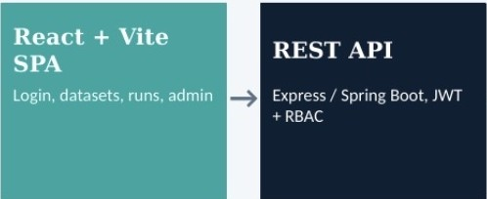
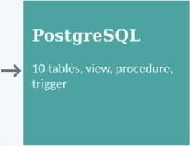
System architecture
HOW IT FITS TOGETHER
Validation engine
Parses CSV, applies rules. scores
Deployed as one unit onVercel: static React build plus serverless API routes under /api. Docker Compose runs the Spring Boot variant locally.
DataPulse
I
BCSE302P Database System• lab
6

Slide 6
Database design: 10 tables in 3NF
RELATIONAL SCHEMA
roles
users
datasets
dataset_fields
validation_rules
validation_runs
quality_issues
issue_resolutions
quality_scores
audit_logs
Single users table: one account table with a role_id foreign key, no separate user tables.
Constraints: PK/FK, NOT NULL, CHECK (field types, severity LOW/MEDIUM/HIGH), UNIQUE (lowercased email, owner+ dataset).
JSONB rule configuration and 8-Tree indexes for fast lookups.
DataPulse I BCSE302P Database Systems Lab
7

Slide 7
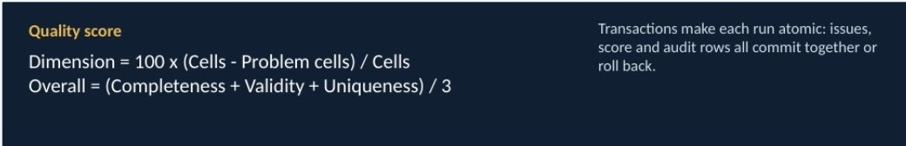
Advanced database objects
IMPLEMENTATION
e View
dataset_quality_summary joins datasets with lateral subqueries for the latest score and live open-issue count.
Stored procedure
e Trigger
trg_audit_quality_issue_change logs every issue insert and status change into audit_logs.
recalculate_quality_score(p_run_id) computes completeness, validity, uniqueness and overall score.
OataPulse I BCSE302P Database Systems Lab
8

Slide 8
Thevalidation engine
HOW A CSV GETS CHECKED
Upload CSV
Parse rows
Apply rules
Store issues
Score + audit
REQUIRED
Field must not be blank
Sample run
Student Attendance & Performance 2026 checked against sample. validation.csv flags duplicate IDs, invalid emails and attendance above 100%.
UNIQUE
No duplicate values in column
EMAIL
Must be a valid address
RANGE
Within min andmax, e.g. 0-100
TYPE
Matches TEXT I INTEGER I DECIMAL I DATE I
BOOLEAN
OataPulse I BCSE302P Database Systems Lab
9

Slide 9
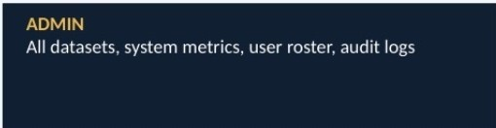
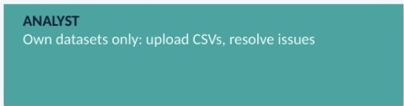
Authentication, RBAC and security
PROTECTING THE DATA
e JWT sessions
Signed bearer tokens on every API call; secret held in environment variables.
BCrypt hashing
e Single users table
Role comes from role_id foreign key.
Passwords are never stored in plain text.
Role-based access
OataPulse I BCSE302P Database Systems Lab
10

Slide 10
Professional practices and DevOps
BEYOND THE CODE
e Git workflow
5 branches (main, dev, backend, frontend, clouddatabase), 10+ commits
Cl/CD
e Docker Compose
PostgreSQL, Spring Boot API and Nginx frontend in one command
GitHub Actions builds frontend, runs tests, packages backend
e Backup and recovery pg_dump I pg restore scripts for Bash and PowerShell
e Automated tests
Node built-in test suite, 10 tests in test/api.test.js
Monitoring
Prometheus-format /api/metrics endpoint
OataPulse I BCSE302P Database Systems lab
12

Slide 11
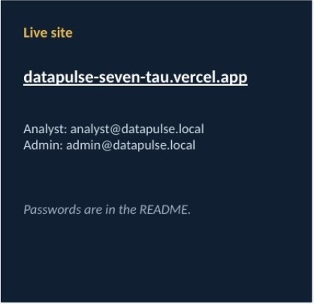
Live demo flow
WALKTHROUGH
l
Log in as analyst@datapulse.local
2
Open the Student Attendance dataset
I
Review fields and validation rules
4
Upload sample_validation.csv
I
Inspect issues and quality score
6
Resolve one issue as FIXED
7
Switch to admin and view audit logs
OataPulse I BCSE302P Database Systems Lab
13

Slide 12
